Slide 1
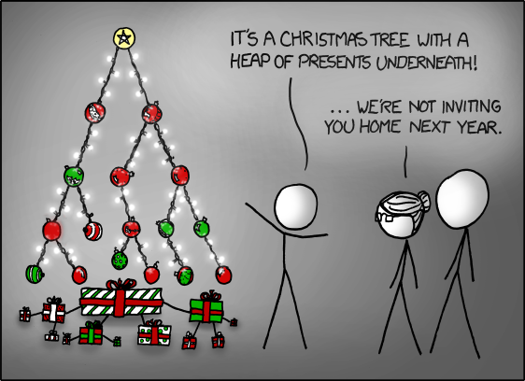
Lecture 15
Applications of priority queues:
Shortest paths in weighted graphs
http://xkcd.com/835/
EECS-214

Slide 2
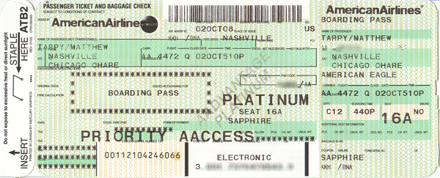
Priority queues
Like normal queues
  Objects wait in line to be processed
However, items have an associated numeric priority
  Priority specified when added to queue
  Objects removed from queue in order of priority
Slightly different API
  Insert(object, priority)
    Adds object with specified priority
  ExtractMax()
    Returns highest priority object

Slide 3
Priority queues
Like normal queues
  Objects wait in line to be processed
However, items have an associated numeric priority
  Priority specified when added to queue
  Objects removed from queue in order of priority
Slightly different API
  Insert(object, priority)
    Adds object with specified priority
  ExtractMin()
    “Min priority queue”
    Returns lowest priority object
    Except that in most applications, we usually want the lower “priorities” first

Slide 4
Heaps
9
Heaps are a simple tree structure for implementing priority queues
Rather than requiring their in-order traveral to be sorted
  We just require that parent nodes be larger than their child nodes
There are lots of exotic types of heaps
  We’ll focus on binary heaps
  Which are complete binary trees with the heap property
  We’ll get to the completeness thing in a minute…
7
8
1
6
4
5
3
2

Slide 5
Heaps
9
Proposition: the largest element of a heap is always its root
Proof:
Suppose some other element is the largest element
Since it isn’t the root, it must have a parent
Since it’s the largest element, it must be larger than its parent
But that contradicts the definition of a heap
So the largest element must be the root
7
8
1
6
4
5
3
2

Slide 6
Binary heaps
A binary heap is a
  Complete binary tree
  That satisfies the heap property
Great!
How do we ensure that the heap is a complete binary tree?
9
7
8
1
6

Slide 7
Embedding in an array
It turns out that any complete binary tree can be embedded an array in a particularly cleaver way
We can compute
  The position of its parent in the array,
  and the positions of its children,
  directly from its own position
9
7
8
1
6

Slide 8
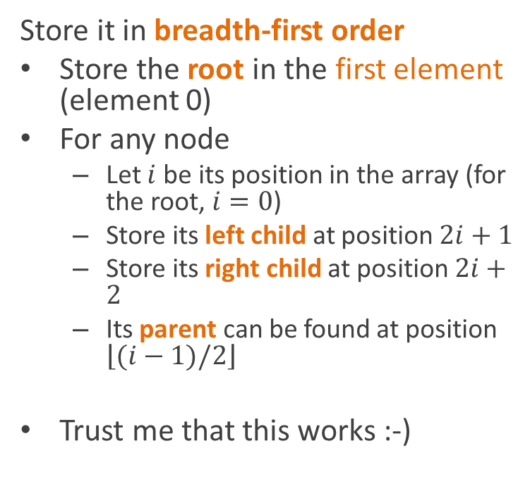
Embedding in an array
Store it in breadth-first order
Store the root in the first element (element 0)
For any node
  Let $i$ be its position in the array (for the root, $i=0$)
  Store its left child at position $2i+1$
  Store its right child at position $2i+2$
  Its parent can be found at position $\left\lfloor (i−1)/2\right\rfloor$
Trust me that this works :-)
9
7
8
1
6
9
7
8
1
6

Slide 9
Heap insertion using the array representation
HeapInsert(A, key)
A.size = A.size + 1
i = A.size
while i>0 and
A[Parent(i)] < key
A[i] = A[Parent(i)]
i = Parent(i)
A[i] = key
9
7
8
1
6
9
7
8
1
6

Slide 10
Extracting an element
HeapExtractMax(A)
max = A[0]
A[0] = A[A.size]
A.size--
Heapify(A,0)
return max
10
7
9
1
6
8
10
7
9
1
6
8

Slide 11
Extracting an element
Heapify(A, i)
l = Left(i)
r = Right(i)
if l≤A.size and A[l]>A[i]
largest = l
else
largest = i
if r≤A.size and A[r]>A[largest]
largest = r
if largest≠i
swap A[i] and A[largest]
Heapify(A, largest)
10
7
9
1
6
8
10
7
9
1
6
8

Slide 12
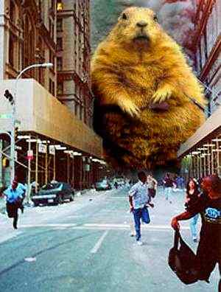
Hamster apocalypse
In 2020, a group of precocious 3rd graders used a home CRISPR system to genetically engineer a race of superhamsters
In 2021, you are the last surviving human in Chicago
You live on the entirely on the purple line, because the hamsters prefer Uber
http://ikkepedia.org/wiki/Hamster

Slide 13
Route planning revisited
Foster
Merchandise Mart
Clark/Lake
State/Lake
Randolf/Wabash
Washington/Wells
Madison/Wabash
Quincy
Adams/Wabash
LaSalle
Library

Slide 14
Route planning revisited
Foster
We used breadth-first search before to find a shortest path in a graph
But BFS treats each edge as being equal
In route planning, different edges take different amounts of time
Merchandise Mart
Clark/Lake
State/Lake
Washington/Wells
Randolf/Wabash
Madison/Wabash
Quincy
Adams/Wabash
LaSalle
Library

Slide 15
Breadth-first search for path finding
Visit nodes in order of increasing distance from the start node
Each time you find a node, remember its predecessor
  It has to be the closest neighbor
Reconstruct the path from predecessor links
BreadthFirstSearch(start) {
q = empty queue
q.Enqueue(start)
start.distance = 0
start.predecessor = null
mark start visited
while q not empty {
node = q.Dequeue()
for each neighbor c
if c not visited {
q.Enqueue(c)
c.distance = node.distance+1
c.predecessor = node
}
}
}

Slide 16
Route planning revisited
We can represent this by weighting edges with their “costs”
  We’ll assume costs > 0
Costs can represent
  Time
  Distance
  Or any other quantity you’d like to minimize
Foster
20
2
Merchandise Mart
Clark/Lake
1
State/Lake
1
Randolf/Wabash
Washington/Wells
1
1
1
Madison/Wabash
Quincy
1
Adams/Wabash
2
LaSalle
Library
1
3

Slide 17
Path finding with edge costs
How do we make a version of BFS that searches nodes
  In order of increasing total path cost
  Rather than increasing number of edges
Use a priority queue!
  Priority of a node = cost of path from start to that node

Slide 18
Dijkstra’s least-cost path algorithm
Dijkstra(G, s, e)
PQ = new priority queue
Set all node costs to infinity
s.cost = 0
for each node n in G
PQ.Insert(n, n.cost)
while PQ not empty
u = PQ.ExtractMin()
if u == e then done!
for each neighbor v of u
w = weight of edge from u to v
newCost = u.cost+w
if newCost<v.cost
PQ.DecreaseKey(v, newCost)
v.cost = newCost
v.predecessor = u
Same basic idea
Visit nodes in order of increasing distance from the start node
  But now distance = total edge cost
Each time you find a node, remember its predecessor
  But now it’s possible to find a long path to a node first
  Then find a shorter path later
  So we have to be ready to update distances rather than just setting them once
Reconstruct the path from predecessor links

Slide 19
Wait a minute… decrease key?
We have to add a new operation to our priority queue: decreasing the priority of an item already in the queue
  Note that since we’re using extract min, rather than extract max, decreasing the “priority” actually moves it ahead in the queue
How could we implement decrease key?

Slide 20
Implementing DecreaseKey
One way we could do it would be to:
  Remove it (somehow)
  Reinsert it
But the insert algorithm
  Adds it at the bottom of the heap
  Swaps it upward until its priority is lower than its parent
    At least for a min heap
HeapInsert(A, key)
A.size = A.size + 1
i = A.size
while i>0 and
A[Parent(i)] > key
A[i] = A[Parent(i)]
i = Parent(i)
A[i] = key

Slide 21
Implementing DecreaseKey
So DecreaseKey is actually easy:
Just move the node up
Until its in the right place
Just copy the code for insert
  And remove the part that starts by inserting it at the end
DecreaseKey(A, i, key)
while i>0 and
A[Parent(i)] > key
A[i] = A[Parent(i)]
i = Parent(i)
A[i] = key

Slide 22
Implementing DecreaseKey
Unfortunately, you need to know where the node is stored in the heap
  i.e. its index in the stupid heap array
Best done by storing the index in the graph node itself
Have to remember to update it any time the node moves in the heap
DecreaseKey(A, i, key)
while i>0 and
A[Parent(i)] > key
A[i] = A[Parent(i)]
i = Parent(i)
A[i] = key

Slide 23
Proving correctness
Notice we have two kinds of nodes
Nodes still in the queue
Nodes that have been removed (that we’re done with)
Dijkstra(G, s, e)
PQ = new priority queue
Set all node costs to infinity
s.cost = 0
for each node n in G
PQ.Insert(n, n.cost)
while PQ not empty
u = PQ.ExtractMin()
if u == e then done!
for each neighbor v of u
w = weight of edge from u to v
newCost = u.cost+w
if newCost<v.cost
PQ.DecreaseKey(v, newCost)
v.cost = newCost
v.predecessor = u

Slide 24
Invariants
For all nodes v
If v is not in the queue,
  dist[v] is the length of the shortest path from the start node to v
If v is in the queue,
  dist[v] is the length of the shortest path from the start to v just using nodes not in the queue
Dijkstra(G, s, e)
PQ = new priority queue
Set all node costs to infinity
s.cost = 0
for each node n in G
PQ.Insert(n, n.cost)
while PQ not empty
u = PQ.ExtractMin()
if u == e then done!
for each neighbor v of u
w = weight of edge from u to v
newCost = u.cost+w
if newCost<v.cost
PQ.DecreaseKey(v, newCost)
v.cost = newCost
v.predecessor = u

Slide 25
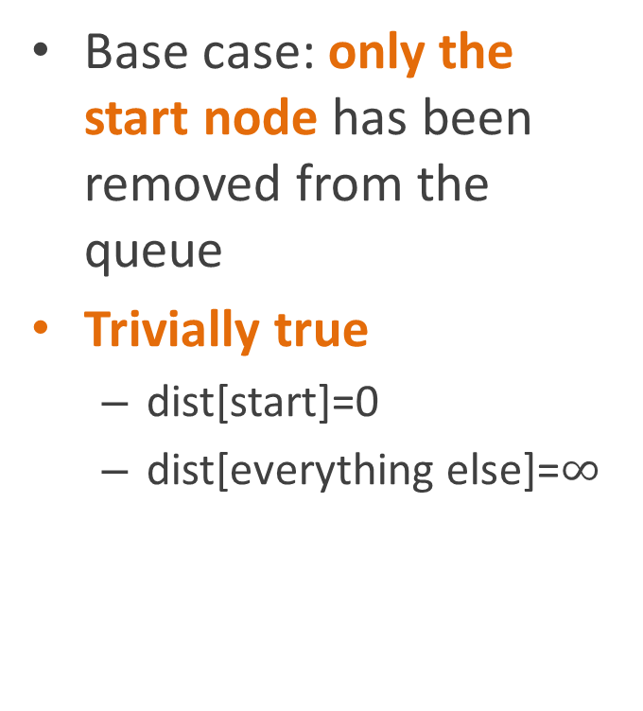
Proof
For all nodes v
If v is not in the queue,
  dist[v] is the length of the shortest path from the start node to v
If v is in the queue,
  dist[v] is the length of the shortest path from the start to v just using nodes not in the queue
Base case: only the start node has been removed from the queue
Trivially true
  dist[start]=0
  dist[everything else]=$∞$

Slide 26
Proof
For all nodes v
If v is not in the queue,
  dist[v] is the length of the shortest path from the start node to v
If v is in the queue,
  dist[v] is the length of the shortest path from the start to v just using nodes not in the queue
Inductive case:
Assume it’s true for the currently visited nodes
Let v be the next node in the queue

Slide 27
Proof
For all nodes v
If v is not in the queue,
  dist[v] is the length of the shortest path from the start node to v
If v is in the queue,
  dist[v] is the length of the shortest path from the start to v just using nodes not in the queue
Inductive case:
Let v be the next node in the queue
Then
  v has the minimum dist[] among the nodes in the queue
  dist[v] is the length of the shortest path to v using nodes not in the queue

Slide 28
Proof
Inductive case:
Let v be the next node in the queue
Then
  v has the minimum dist[] among the nodes in the queue
  dist[v] is the length of the shortest path to v using nodes not in the queue
Claim:
dist[v] is the length of the shortest path using any nodes
Proof:
  Assume there’s a shorter path
  Case 1: the shorter path contains a node in the queue
    Then that node must be closer to start than v
      Because edge costs > 0
    Contradicts (1)

Slide 29
Proof
Inductive case:
Let v be the next node in the queue
Then
  v has the minimum dist[] among the nodes in the queue
  dist[v] is the length of the shortest path to v using nodes not in the queue
Claim:
dist[v] is the length of the shortest path using any nodes
Proof:
  Assume there’s a shorter path
  Case 2: the shorter path contains no nodes from the queue
    Contradicts (2)

Slide 30
Proof
Inductive case:
Let v be the next node in the queue
Then
  v has the minimum dist[] among the nodes in the queue
  dist[v] is the length of the shortest path to v using nodes not in the queue
Therefore:
The inductive case holds
The invariants hold
  Including when the queue is empty
  At which point dist[] has the distances to all the nodes
The algorithm is correct

Slide 31
Running Dijkstra’s algorithm
Foster
20
2
Merchandise Mart
Clark/Lake
1
State/Lake
1
Randolf/Wabash
Washington/Wells
1
1
1
Madison/Wabash
Quincy
1
Adams/Wabash
2
LaSalle
Library
1
3

Slide 32
Initialize node costs
Foster
0
20
2
Merchandise Mart
Clark/Lake
1
State/Lake
1
∞
Randolf/Wabash
Washington/Wells
∞
∞
1
∞
∞
1
1
Madison/Wabash
Quincy
∞
1
∞
Adams/Wabash
2
LaSalle
Library
∞
1
3
∞
∞

Slide 33
Initialize priority queue
Queue:
Foster (0)
Adams (∞)
Clark (∞)
LaSalle (∞)
Library (∞)
Madison (∞)
Mmart (∞)
Quincy (∞)
Randolf (∞)
State (∞)
Washington (∞)
Foster
0
20
2
Merchandise Mart
Clark/Lake
1
State/Lake
1
∞
Randolf/Wabash
Washington/Wells
∞
∞
1
∞
∞
1
1
Madison/Wabash
Quincy
∞
1
∞
Adams/Wabash
2
LaSalle
Library
∞
1
3
∞
∞

Slide 34
Extract min (Foster)
Queue:
Adams (∞)
Clark (∞)
LaSalle (∞)
Library (∞)
Madison (∞)
Mmart (∞)
Quincy (∞)
Randolf (∞)
State (∞)
Washington (∞)
Foster
0
20
2
Merchandise Mart
Clark/Lake
1
State/Lake
1
∞
Randolf/Wabash
Washington/Wells
∞
∞
1
∞
∞
1
1
Madison/Wabash
Quincy
∞
1
∞
Adams/Wabash
2
LaSalle
Library
∞
1
3
∞
∞

Slide 35
Update neighbors
Queue:
State (20)
Adams (∞)
Clark (∞)
LaSalle (∞)
Library (∞)
Madison (∞)
Mmart (∞)
Quincy (∞)
Randolf (∞)
Washington (∞)
Foster
0
20
2
Merchandise Mart
Clark/Lake
1
State/Lake
1
∞
Randolf/Wabash
Washington/Wells
∞
20
1
∞
∞
1
1
Madison/Wabash
Quincy
∞
1
∞
Adams/Wabash
2
LaSalle
Library
∞
1
3
∞
∞

Slide 36
Extract min (State)
Queue:
Adams (∞)
Clark (∞)
LaSalle (∞)
Library (∞)
Madison (∞)
Mmart (∞)
Quincy (∞)
Randolf (∞)
Washington (∞)
Foster
0
20
2
Merchandise Mart
Clark/Lake
1
State/Lake
1
∞
Randolf/Wabash
Washington/Wells
∞
20
1
∞
∞
1
1
Madison/Wabash
Quincy
∞
1
∞
Adams/Wabash
2
LaSalle
Library
∞
1
3
∞
∞

Slide 37
Update neighbors
Queue:
Clark (21)
Randolf (21)
Adams (∞)
LaSalle (∞)
Library (∞)
Madison (∞)
Mmart (∞)
Quincy (∞)
Washington (∞)
Foster
0
20
2
Merchandise Mart
Clark/Lake
1
State/Lake
1
∞
Randolf/Wabash
Washington/Wells
21
20
1
21
∞
1
1
Madison/Wabash
Quincy
∞
1
∞
Adams/Wabash
2
LaSalle
Library
∞
1
3
∞
∞

Slide 38
Extract min (Clark)
Queue:
Randolf (21)
Adams (∞)
LaSalle (∞)
Library (∞)
Madison (∞)
Mmart (∞)
Quincy (∞)
Washington (∞)
Foster
0
20
2
Merchandise Mart
Clark/Lake
1
State/Lake
1
∞
Randolf/Wabash
Washington/Wells
21
20
1
21
∞
1
1
Madison/Wabash
Quincy
∞
1
∞
Adams/Wabash
2
LaSalle
Library
∞
1
3
∞
∞

Slide 39
Update neighbors
Queue:
Randolf (21)
Wash (22)
Mmart (23)
Adams (∞)
LaSalle (∞)
Library (∞)
Madison (∞)
Quincy (∞)
Foster
0
20
2
Merchandise Mart
Clark/Lake
1
State/Lake
1
23
Randolf/Wabash
Washington/Wells
21
20
1
21
22
1
1
Madison/Wabash
Quincy
∞
1
∞
Adams/Wabash
2
LaSalle
Library
∞
1
3
∞
∞

Slide 40
Extract min (Randolf)
Queue:
Mmart (22)
Wash (22)
Adams (∞)
LaSalle (∞)
Library (∞)
Madison (∞)
Quincy (∞)
Foster
0
20
2
Merchandise Mart
Clark/Lake
1
State/Lake
1
22
Randolf/Wabash
Washington/Wells
21
20
1
21
22
1
1
Madison/Wabash
Quincy
∞
1
∞
Adams/Wabash
2
LaSalle
Library
∞
1
3
∞
∞

Slide 41
Update neighbors
Queue:
Wash (22)
Madison (22)
Mmart (23)
Adams (∞)
LaSalle (∞)
Library (∞)
Quincy (∞)
Foster
0
20
2
Merchandise Mart
Clark/Lake
1
State/Lake
1
23
Randolf/Wabash
Washington/Wells
21
20
1
21
22
1
1
Madison/Wabash
Quincy
22
1
∞
Adams/Wabash
2
LaSalle
Library
∞
1
3
∞
∞

Slide 42
Extract min (Washington)
Queue:
Madison (22)
Mmart (23)
Adams (∞)
LaSalle (∞)
Library (∞)
Quincy (∞)
Foster
0
20
2
Merchandise Mart
Clark/Lake
1
State/Lake
1
23
Randolf/Wabash
Washington/Wells
21
20
1
21
22
1
1
Madison/Wabash
Quincy
22
1
∞
Adams/Wabash
2
LaSalle
Library
∞
1
3
∞
∞

Slide 43
Update neighbors
Queue:
Madison (22)
Mmart (23)
Quincy (23)
Adams (∞)
LaSalle (∞)
Library (∞)
Foster
0
20
2
Merchandise Mart
Clark/Lake
1
State/Lake
1
23
Randolf/Wabash
Washington/Wells
21
20
1
21
22
1
1
Madison/Wabash
Quincy
22
1
23
Adams/Wabash
2
LaSalle
Library
∞
1
3
∞
∞

Slide 44
Extract min (Madison)
Queue:
Mmart (23)
Quincy (23)
Adams (∞)
LaSalle (∞)
Library (∞)
Foster
0
20
2
Merchandise Mart
Clark/Lake
1
State/Lake
1
23
Randolf/Wabash
Washington/Wells
21
20
1
21
22
1
1
Madison/Wabash
Quincy
22
1
23
Adams/Wabash
2
LaSalle
Library
∞
1
3
∞
∞

Slide 45
Update neighbors
Queue:
Mmart (23)
Quincy (23)
Adams (23)
LaSalle (∞)
Library (∞)
Foster
0
20
2
Merchandise Mart
Clark/Lake
1
State/Lake
1
23
Randolf/Wabash
Washington/Wells
21
20
1
21
22
1
1
Madison/Wabash
Quincy
22
1
23
Adams/Wabash
2
LaSalle
Library
23
1
3
∞
∞

Slide 46
Extract min (MMart)
Queue:
Quincy (23)
Adams (23)
LaSalle (∞)
Library (∞)
Foster
0
20
2
Merchandise Mart
Clark/Lake
1
State/Lake
1
23
Randolf/Wabash
Washington/Wells
21
20
1
21
22
1
1
Madison/Wabash
Quincy
22
1
23
Adams/Wabash
2
LaSalle
Library
23
1
3
∞
∞

Slide 47
Update neighbors (no changes)
Queue:
Quincy (23)
Adams (23)
LaSalle (∞)
Library (∞)
Foster
0
20
2
Merchandise Mart
Clark/Lake
1
State/Lake
1
23
Randolf/Wabash
Washington/Wells
21
20
1
21
22
1
1
Madison/Wabash
Quincy
22
1
23
Adams/Wabash
2
LaSalle
Library
23
1
3
∞
∞

Slide 48
Extract min (Quincy)
Queue:
Adams (23)
LaSalle (∞)
Library (∞)
Foster
0
20
2
Merchandise Mart
Clark/Lake
1
State/Lake
1
23
Randolf/Wabash
Washington/Wells
21
20
1
21
22
1
1
Madison/Wabash
Quincy
22
1
23
Adams/Wabash
2
LaSalle
Library
23
1
3
∞
∞

Slide 49
Done!
Queue:
Adams (23)
LaSalle (∞)
Library (∞)
Foster
0
20
2
Merchandise Mart
Clark/Lake
1
State/Lake
1
23
Randolf/Wabash
Washington/Wells
21
20
1
21
22
1
1
Madison/Wabash
Quincy
22
1
23
Adams/Wabash
2
LaSalle
Library
23
1
3
∞
∞

Slide 50
And we have our minimum cost path
Foster
0
20
2
Merchandise Mart
Clark/Lake
1
State/Lake
1
23
Randolf/Wabash
Washington/Wells
21
20
1
21
22
1
1
Madison/Wabash
Quincy
22
1
23
Adams/Wabash
2
LaSalle
Library
23
1
3
∞
∞

Slide 51
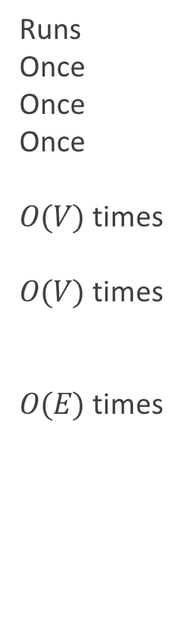
How long does it take?
Runs
Once
Once
Once
$O(V)$ times
$O(V)$ times
$O(E)$ times
Dijkstra(G, s, e)
PQ = new priority queue
Set all node costs to infinity
s.cost = 0
for each node n in G
PQ.Insert(n, n.cost)
while PQ not empty
u = PQ.ExtractMin()
if u == e then done!
for each neighbor v of u
w = weight of edge from u to v
newCost = u.cost+v
if newCost<v.cost
PQ.DecreaseKey(v, newCost)
v.cost = newCost
v.predecessor = u

Slide 52

How long does it take?
Time per execution
$$O(1) \\ O(V) \\ O(1)$$
$$O(\log{V})$$
$$O\left(\log{V}\right) \\ O(1)$$
$$O(1)$$
$$O(\log{V})$$
$$O(1)$$
Dijkstra(G, s, e)
PQ = new priority queue
Set all node costs to infinity
s.cost = 0
for each node n in G
PQ.Insert(n, n.cost)
while PQ not empty
u = PQ.ExtractMin()
if u == e then done!
for each neighbor v of u
w = weight of edge from u to v
newCost = u.cost+v
if newCost<v.cost
PQ.DecreaseKey(v, newCost)
v.cost = newCost
v.predecessor = u

Slide 53


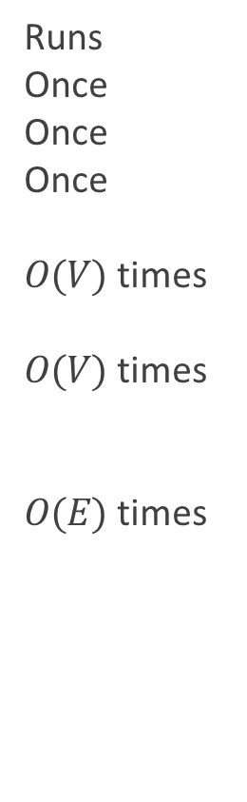
How long does it take?
Runs
Once
Once
Once
$O(V)$ times
$O(V)$ times
$O(E)$ times
Time
$$O(1) \\ O(V) \\ O(1)$$
$$O(\log{V})$$
$$O\left(\log{V}\right) \\ O(1)$$
$$O(1)$$
$$O(\log{V})$$
$$O(1)$$
Total
$$O(1) \\ O(V) \\ O(1)$$
$$O(\operatorname{Vlog}{V})$$
$$O\left(V\log{V}\right) \\ O(V)$$
$$O(E)$$
$$O(\operatorname{Elog}{V})$$
$$O(E)$$
Dijkstra(G, s, e)
PQ = new priority queue
Set all node costs to infinity
s.cost = 0
for each node n in G
PQ.Insert(n, n.cost)
while PQ not empty
u = PQ.ExtractMin()
if u == e then done!
for each neighbor v of u
w = weight of edge from u to v
newCost = u.cost+v
if newCost<v.cost
PQ.DecreaseKey(v, newCost)
v.cost = newCost
v.predecessor = u

Slide 54
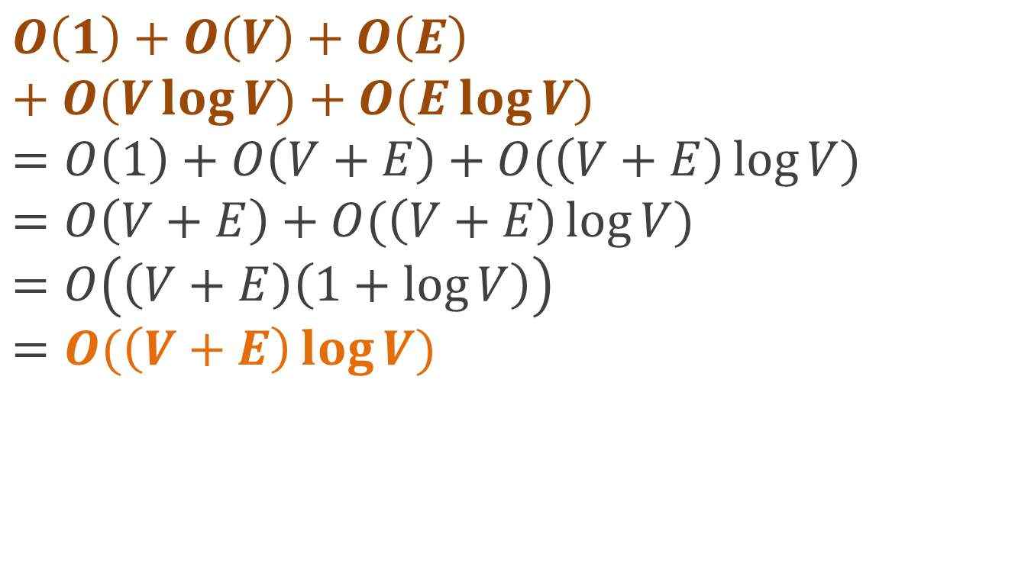
How long does it take?
$$O\left(1\right)+O\left(V\right)+O\left(E\right)+O(V\log{V)+O(E\log{V)}} \\ =O\left(1\right)+O\left(V+E\right)+O(\left(V+E\right)\log{V)} \\ =O\left(V+E\right)+O(\left(V+E\right)\log{V)} \\ =O\left(\left(V+E\right)\left(1+log{V}\right)\right) \\ =O(\left(V+E\right)\log{V})$$

Slide 55
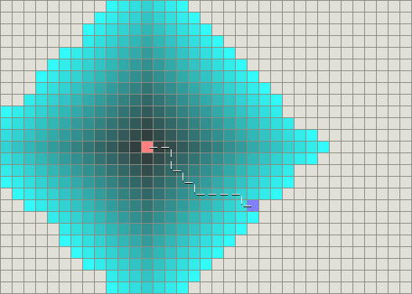
Searching for a path in a 4-connected grid
Source: http://theory.stanford.edu/~amitp/GameProgramming/AStarComparison.html

Slide 56
Dijkstra does a lot of useless searching
Dijkstra’s algorithm is a blind search algorithm
  It exhaustively explores nodes in increasing order of distance
  Even if they’re in the opposite direction from the goal!
Is there some way of biasing the search toward more productive nodes?
  Search the more promising nodes first

Slide 57
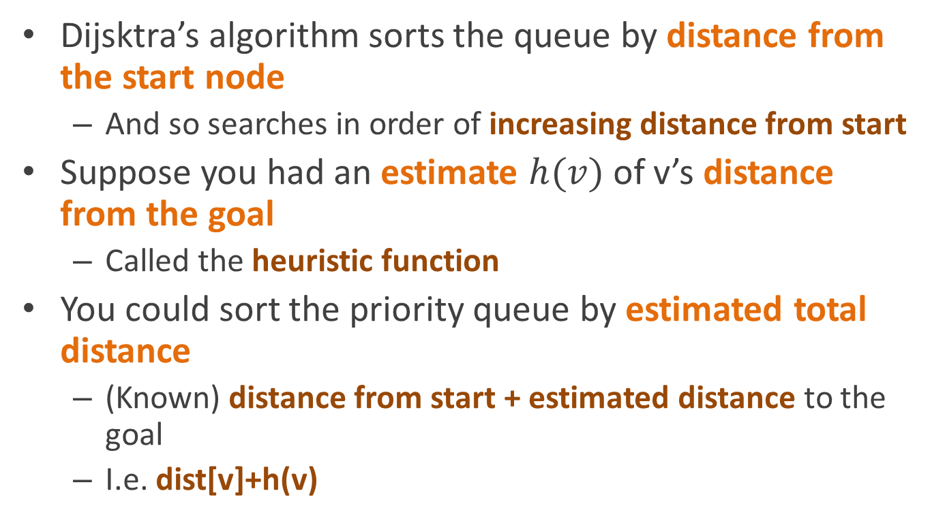
Heuristic search
Dijsktra’s algorithm sorts the queue by distance from the start node
  And so searches in order of increasing distance from start
Suppose you had an estimate $h(v)$ of v’s distance from the goal
  Called the heuristic function
You could sort the priority queue by estimated total distance
  (Known) distance from start + estimated distance to the goal
  I.e. dist[v]+h(v)

Slide 58
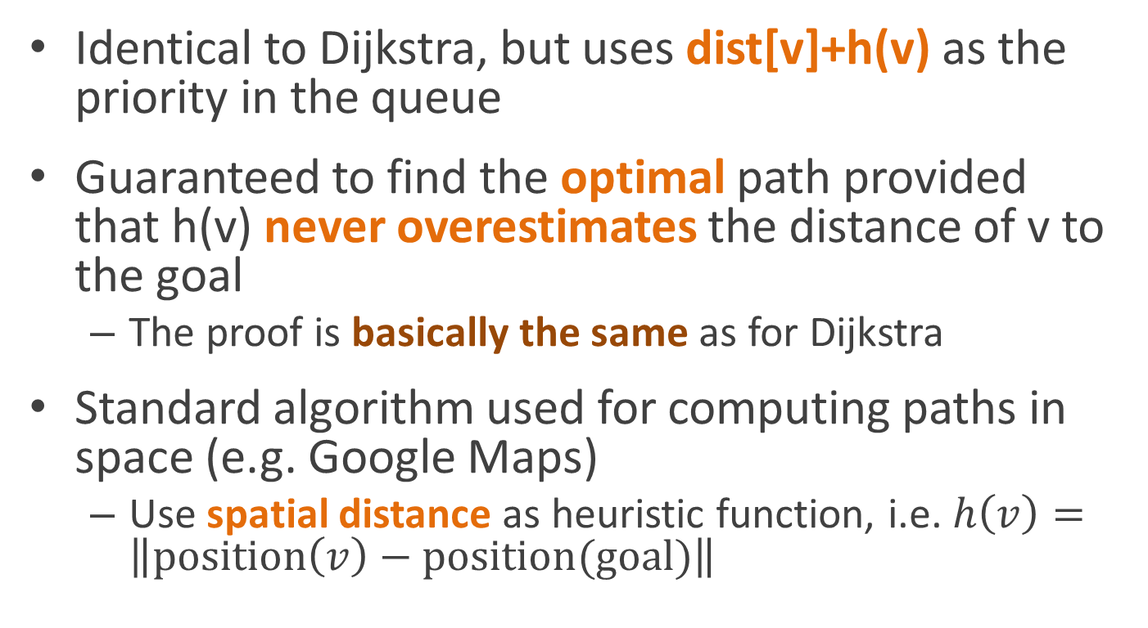
A* search
Identical to Dijkstra, but uses dist[v]+h(v) as the priority in the queue
Guaranteed to find the optimal path provided that h(v) never overestimates the distance of v to the goal
  The proof is basically the same as for Dijkstra
Standard algorithm used for computing paths in space (e.g. Google Maps)
  Use spatial distance as heuristic function, i.e. $h\left(v\right)=\left\|position\left(v\right)−position(goal)\right\|$

Slide 59
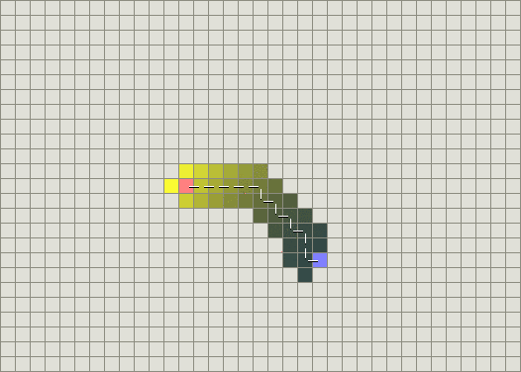
A* is way more efficient
(when your problem has a heuristic function)

Slide 60
Reading
CLR chapter 24.3 (Dijkstra’s Algorithm)

